Slide 1
FLOW RATE OUT OF SPECIFICATION (Error 092) INVESTIGATION

Slide 2
Issue Definition
What We Know
Analysis of Error 092
Investigations and Results

Slide 3
Issue Definition
A large number of KPs are experiencing flow rate out of spec (error 092). This is when the measured flow rate is outside of the specified 1.0 -1.8 l/min. Field maintenance team has been using the troubleshooting guide to address the issue.
The goal is reduce / eliminate the number of flow rate out of spec occurrences.

Slide 4
What We Know
Multiple KPs have experienced error 092 (flow rate out of spec) multiple times
Build up of fuel in the airline ranges from 4 to 75ml
Friction between dock parts 2 (dock air housing) and 3 (dock fuel housing)
Flow rate is checked instantaneously
Customer behaviour is also contributing to error 092
Week 49: A number of customers are successfully dispensing 2106ml, which they immediately follow with another dispense resulting to 092

Slide 5
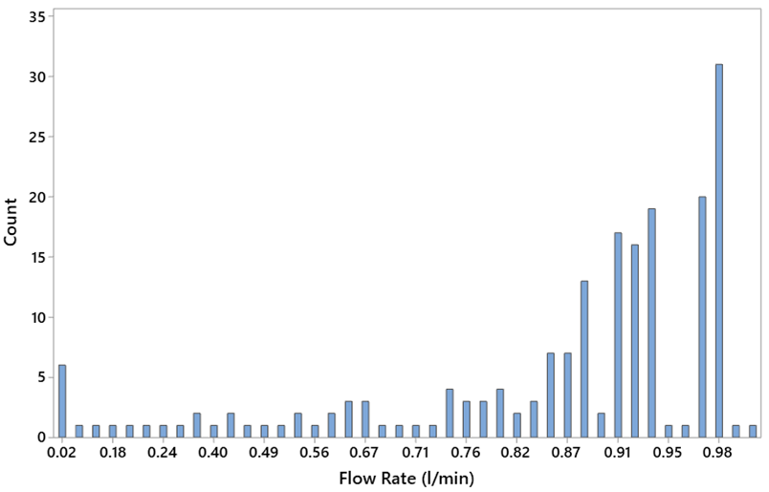
Error 092; Measured Flow Rate
Not included in the graph is the 165 occurrences of zero flow rate.
190 occurrences had flow rate between 0.02 - 0.98 l/min
2 occurrences had flow rates above 1 l/min
NB: Data source DB

Slide 6
Error 092 Investigation
Potential Failure Mode | Freq | Potential Cause | Short Term | To Be Investigated
Accumulation of fuel in the return air line | 55 | Incomplete sealing of the dock parts 2 and 3 during a dispense Gasket small or not inserted properly during assembly process | Change the SMV Drain fuel from air line Grease o-ring | Investigate the use of 3.5mm gasket instead of 2.5mm Investigate the use of grease in ensuring a good sealing between dock part 2 & 3 Does reducing FRL threshold allow a overfull airline to clear back into the tank, and if so what is the min FRL required to allow that to happen
Air accumulated in the dispense fuel line | 6 | Air lock around the flowmeter due to KP infrequent use of the KP Dispensing when KP tank is empty | Prime the dispense fuel line | What is the min time required to allow a fuel line with air in it to be fully primed
Flowmeter | 5 | Flowmeter not sending pulses Flowmeter sending intermittent pulses | N/A | Further analysis on the faulty flowmeter
Smart valve | 2 | Incomplete sealing between dock parts 2 and 3 (allowing fuel to flow freely into the airline) | Disassemble and reassemble SMV, and test.
NB: Data source Freshservice Tickets (Sept 1 - Nov 15)

Slide 7
Cont. Error 092 Investigation
Potential Failure Mode | Freq | Potential Cause | Short Term | To Be Investigated
Pump | 3 | Pump not running | N/A | Pump to be further analyzed
Solenoid | 1 | Malfunctioning solenoid | N/A
KPC | 1 |  | N/A | KPC to be investigated further
Pressurized canister | No data | Canister stored near a heat source | N/A
Pressurized KP tank | No data | Pressure relief valves not working as expected | N/A
NB: Data source Freshservice Tickets (1 Sept - 15 Nov)

Slide 8
Field Investigation
KP # | % Error 092 Dispenses | Resolution | Recurrence since resolution
KP-0217 | 62 | Replaced flow meter | None
KP-0541 | 16 | Increased the FRH to 1.9l/min (system measures high flow rate) | Once (faulty canister)
KP-0555 | 69 | Replaced dispense tray | None
KP-0394 | 20 | Replaced pump | Once (faulty canister
KP-0337 | 81 | Replaced pump | None
KP-0028 | 21 | DV terminals firmly reinserted | None
KP-0424 | 81 | KPC replaced | None
KP-0268 | 100 | Cleaned the clogged smartvalve | None
KP-0231 | 45 | SMV and below left D-sub cable replaced | Once (faulty canister)

Slide 9
Test 1: Grease Application to O-rings
Grease o-rings to ease the dock fuel housing travel down the dock air housing.
KP### Date Recurrence
KP-0030 29th Oct Error 092 occured after 12 days
KP-0070 8th Nov Error 092 occured after 24 days
KP-0180 21st Nov None
KP-0769 22nd Nov None

Slide 10
Test 2: 3.5mm Gasket In Place of 2.5mm
To better seal the holes on the dock fuel housing when a canister is docked to reduce the amount of fuel entering the airline.
KP### Date Recurrence
KP-0030 15th Nov Error 092 25th Nov
KP-0769 22nd Nov None
KP-0231 21st Nov None

Slide 11
Test 3: Reduce flow rate
Determine the low flow rate threshold required to empty build up of fuel in the airline
Gradually filled the airline with fuel from 14 to 100 ml in increments of 5 ml and set the FRL to 0.5l/min on KP-0030.
Observed: Fuel in excess of 35ml in the airline the flow rate drops to 0.9l/min for 3-5 seconds.
Recommended: Lower the FRL min to 0.85l/min to allow fuel in airline to be cleared during a dispense without an error 092.
KP-0030 FRL set to 0.85l/min on 26th November, 2019.

Slide 12
Test 3: Reduced Flow rate (FRL)
KP### Date Recurrence
KP-0030 26th Nov Error 092 25th Nov
All KPs 18th Dec

Slide 13
Actions Taken
Train (hands-on) maintenance team on troubleshooting error 092 - Done
Update 092 troubleshooting flowcharts - Done
Update KP troubleshooting -

